Slide 1
EM Algorithm
Expectation and Maximization algorithm

Slide 2
In a machine learning application, there might a few relevant variables present in the data set that may go unobserved while learning. In this article, we will learn about the Expectation-Maximization or EM algorithm in learning to understand the estimation of latent variables using the observed data.
Problem Of Latent Variables For Maximum Likelihood
In statistic modeling, a common problem arises as to how can we try to estimate the joint probability distribution for a data set.
Probability Density estimation is basically the construction of an estimate based on observed data. It involves selecting a probability distribution function and the parameters of that function that best explains the joint probability of the observed data.

Slide 3
What is EM Algorithm In Machine Learning?
EM algorithm was proposed in 1997 by Arthur Dempster, Nan Laird, and Donald Rubin. It is basically used to find the local maximum likelihood parameters of a statistical model in case the latent variables are present or the data is missing or incomplete.

Slide 4
The EM Algorithm follows the following steps in order to find the relevant model parameters in the presence of latent variables.
Consider a set of starting parameters in incomplete data.
Expectation Step – This step is used to estimate the values of the missing values in the data. It involves the observed data to basically guess the values in the missing data.
Maximization Step – This step generates complete data after the Expectation step updates the missing values in the data.
Execute the step 2 and 3 until the convergence is met.
Convergence – The concept of convergence in probability is based on intuition. Let’s say we have two random variables if the probability of their difference is very small, it is said to be converged. In this case, convergence means if the values match each other.

Slide 5
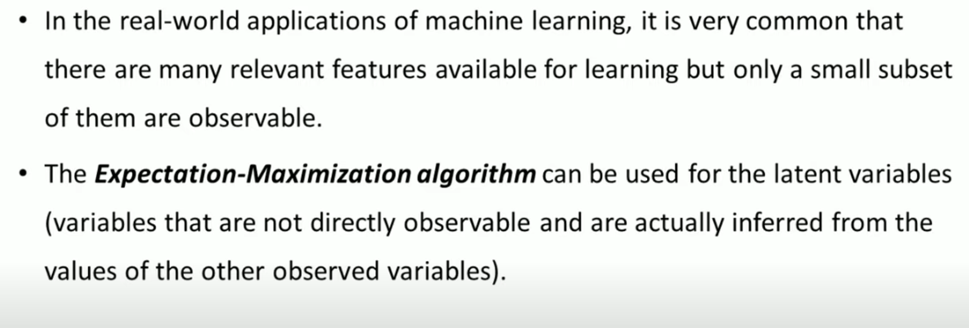

Slide 6
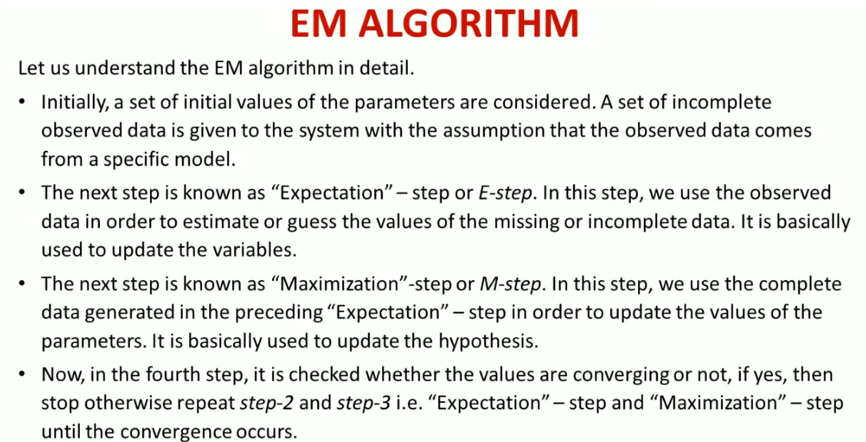
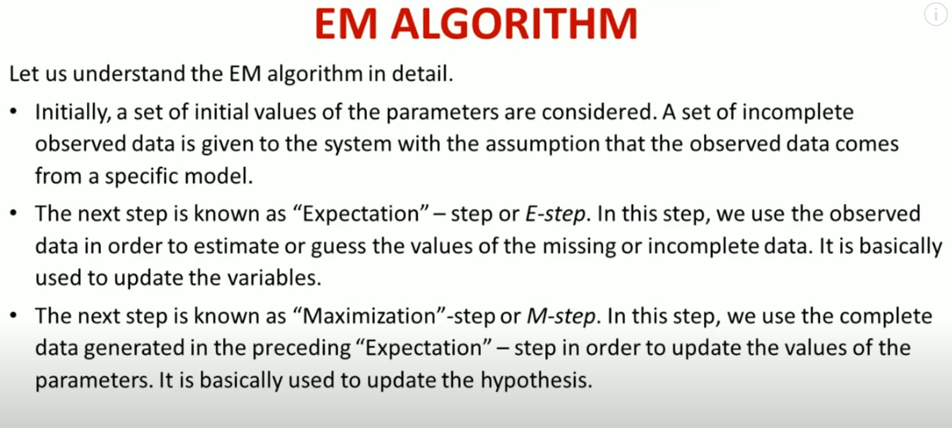

Slide 7
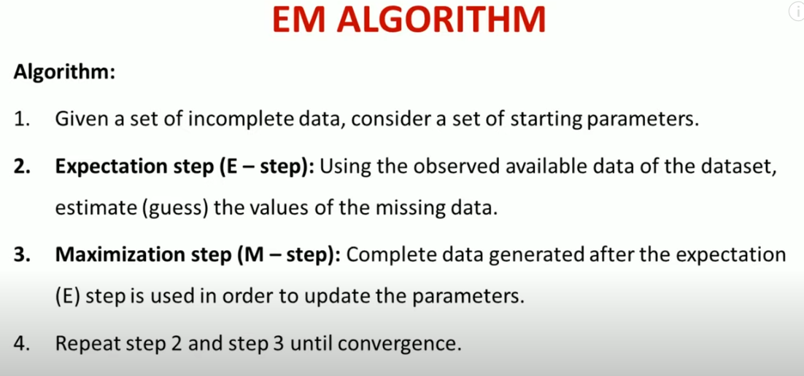

Slide 8
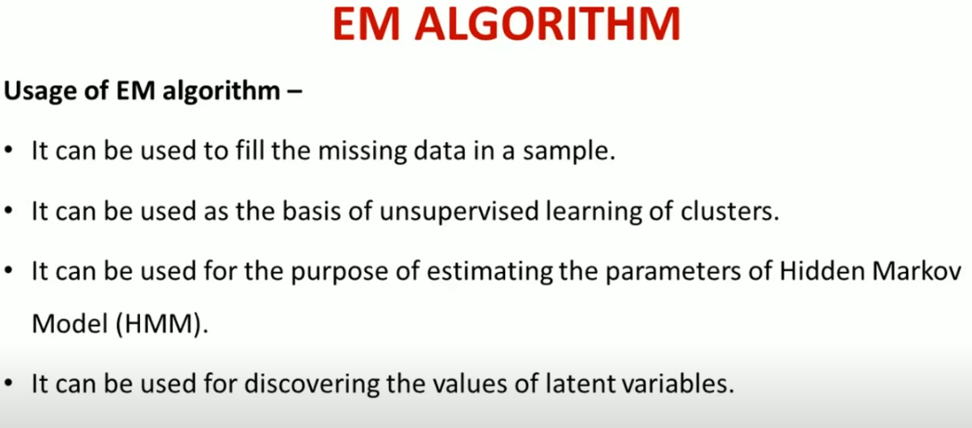

Slide 9
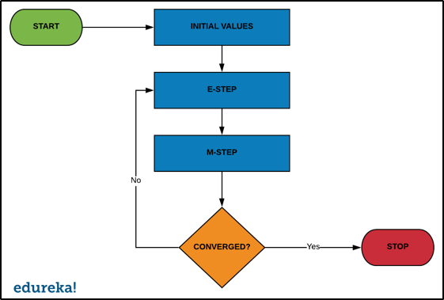
How Does It Work?

Slide 10
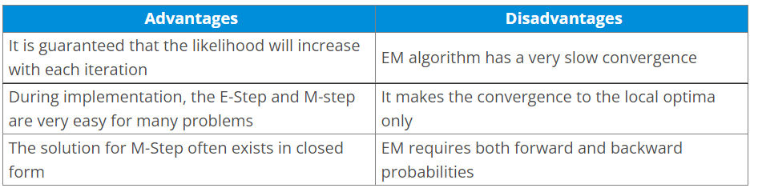
Advantages And Disadvantages of EM

Slide 11
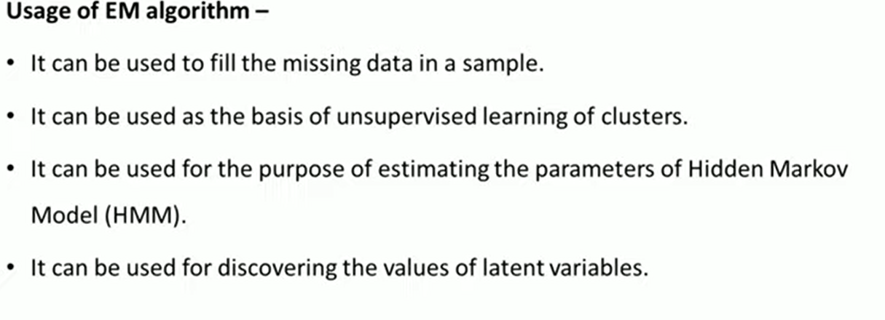

Slide 12
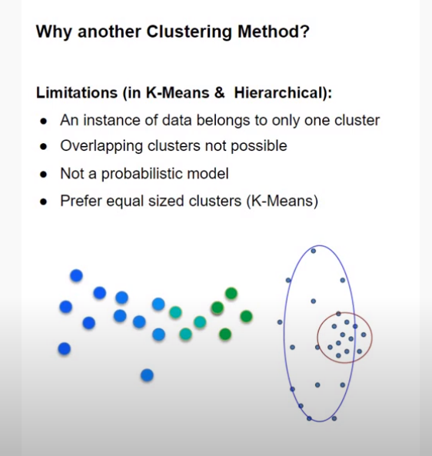
EM algorithm for Clustering
Why we need EM for clustering even when we have Kmeans clustering

Slide 13
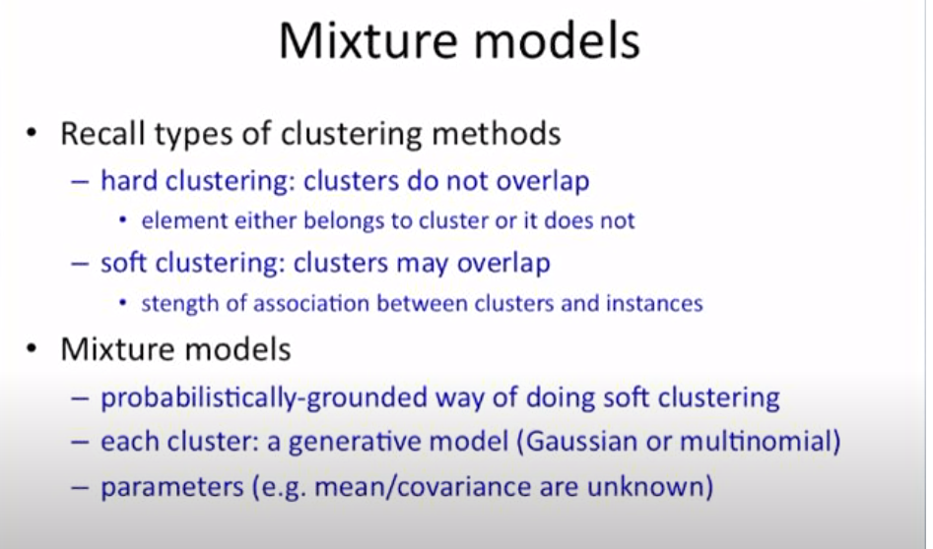

Slide 14
In the context of clustering, a generative model refers to a probabilistic model that assumes that the data is generated from a specific underlying distribution or process.

Slide 15
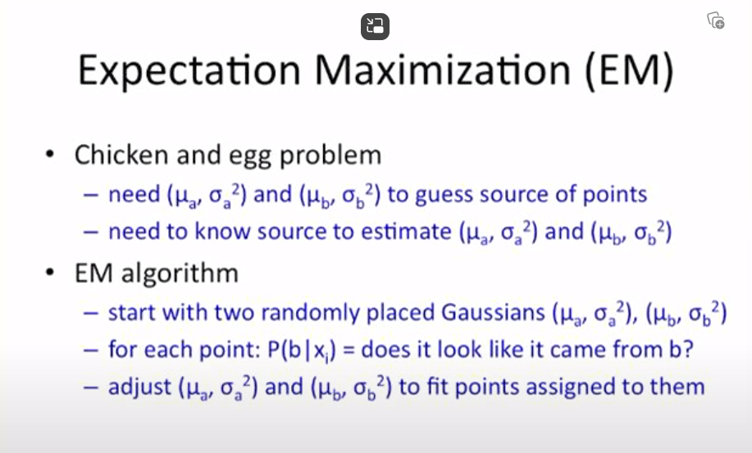

Slide 16
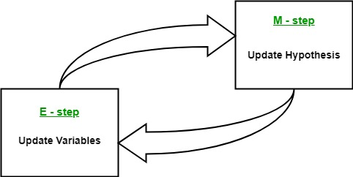
In the E step, the algorithm computes the latent variables i.e. expectation of the log-likelihood using the current parameter estimates.
In the M step, the algorithm determines the parameters that maximize the expected log-likelihood obtained in the E step, and corresponding model parameters are updated based on the estimated latent variables.

Slide 17
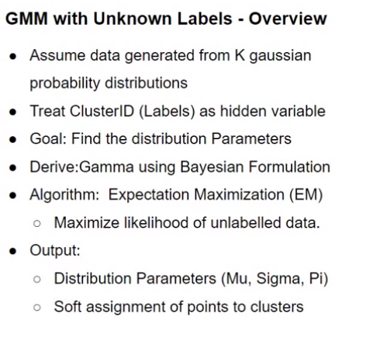
EM algorithm for Clustering

Slide 18
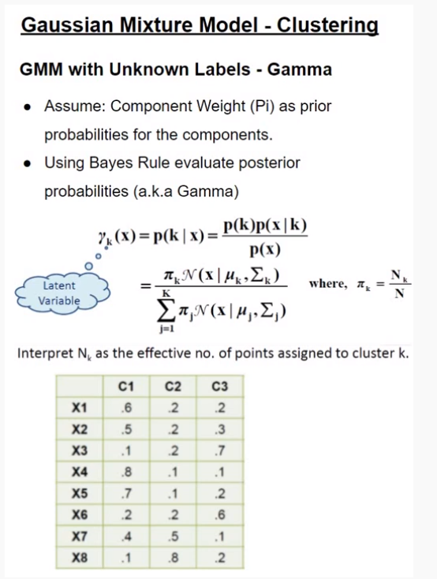

Slide 19
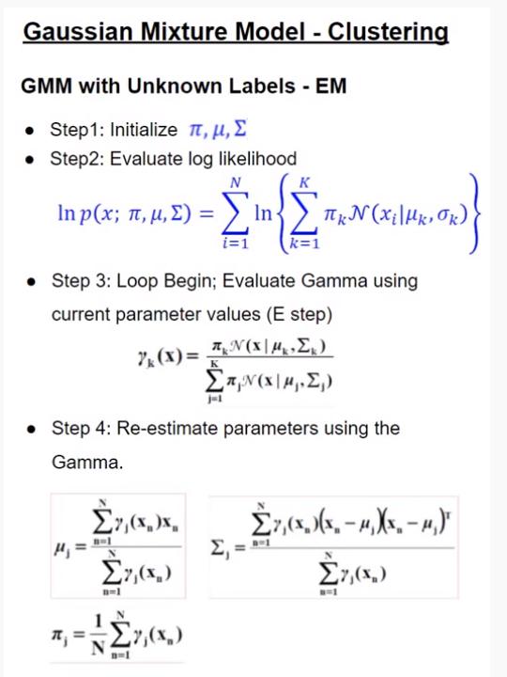
Expectation-Maximization (EM) algorithm for unsupervised learning clustering (imp)
Mixing weight, mean, covariance matrix
N: Sum over N datapoints
K-data generated from k gaussian mixture models
Likelihood of data
Probability that x belongs to a cluster or distribution
Refine the parameters

Slide 20
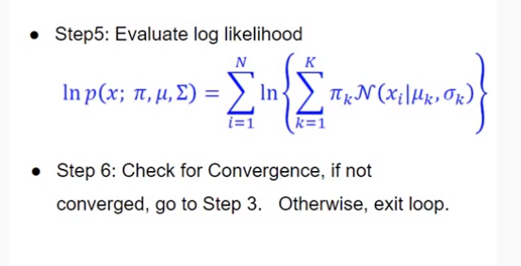

Slide 21
Important References
How to use Gaussian Mixture Models, EM algorithm for Clustering? | Machine Learning Step By Step – YouTube
EM Algorithm : Data Science Concepts - YouTube

